Slide 1

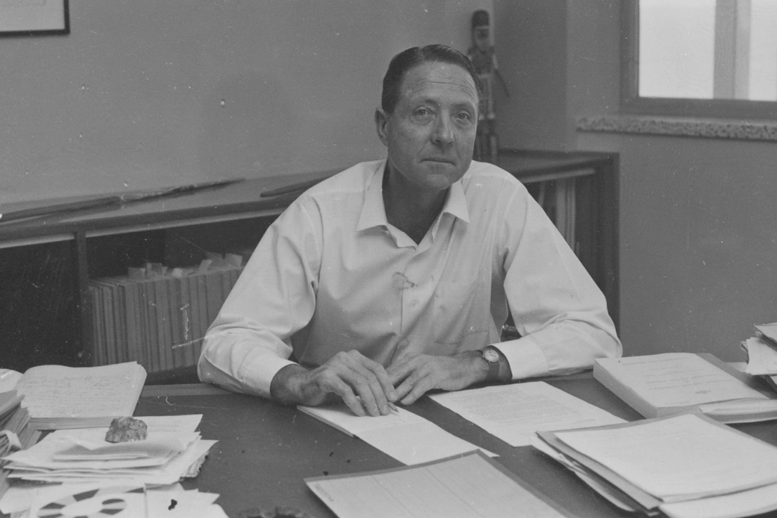

Harry Giese
Early Childhood Champion

Slide 2


Copyright
This work is licensed under a Creative Commons Attribution 4.0 International Licence and qualifies as a Free Culture License.
Attribution
It is to be attributed as follows:
Title: Harry Giese: Early Childhood Champion
Author: Sue Reaburn
© 2016 Early Childhood Association - Northern Territory Branch
Individual pieces of content must also be additionally attributed as identified on the item when shared or adapted separately to this work as a whole.
Additional Conditions
Permission is required of people using material in course packs and other education material and can be requested at educationmob@iinet.net.au

Slide 3
WARNING
Aboriginal and Torres Strait Islander people are advised that this presentation contains the names and images of people who have passed away.

Slide 4
About this presentation
This presentation presents one of the early pioneers who shaped Preschool Education.
Information in this presentation is garnered from a number of sources:
Harry Christian Giese Collection, 15-036, Arafura Research Archive, Charles Darwin University
Interviews with Harry Giese, NTRS 226, TS 755, Northern Territory Archives Service
Northern Territory Library, Giese (PH0351) and Tschirner (PH0703) Collections, Territory Stories/PictureNT
Diana Giese – personal communication
Thanks to Diana Giese and David Morgan for sub-edits.
Errors of fact and omissions are the responsibility of the developer, Sue Reaburn.

Slide 5
Mr Harry C. Giese: Summary
On 13 May 1954, Harry Giese was appointed as the first Director of Welfare in the Northern Territory Administration of post-war reconstruction.
He was to introduce bills into the NT Legislative Council that set the framework for completely new policy and new administrative approaches to Aboriginal affairs.
Tschirner Collection, Northern Territory Library PH703-0463

Slide 6
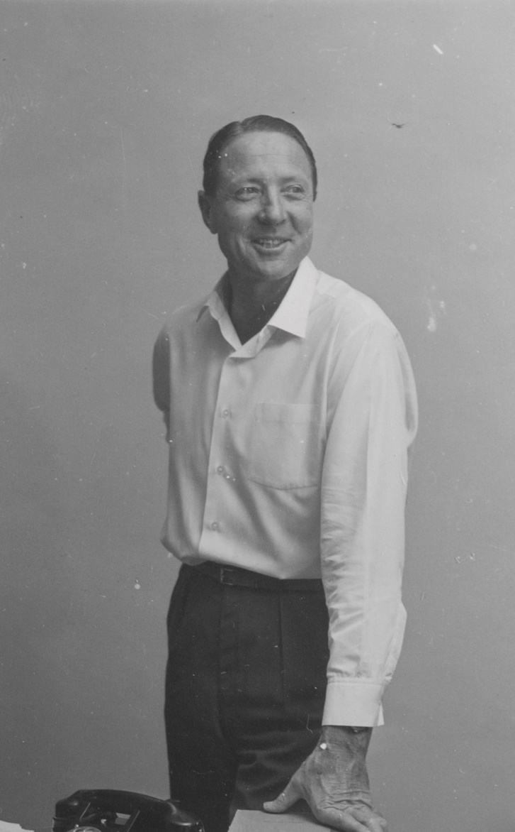
He was a trained teacher
Trained at the Universities of Western Australia and Melbourne, Harry taught in his home state of W.A. and in Queensland, where he was the first Director of Physical Education, before becoming Commonwealth National Fitness Officer.
Tschirner Collection, Northern Territory Library PH703-0463

Slide 7
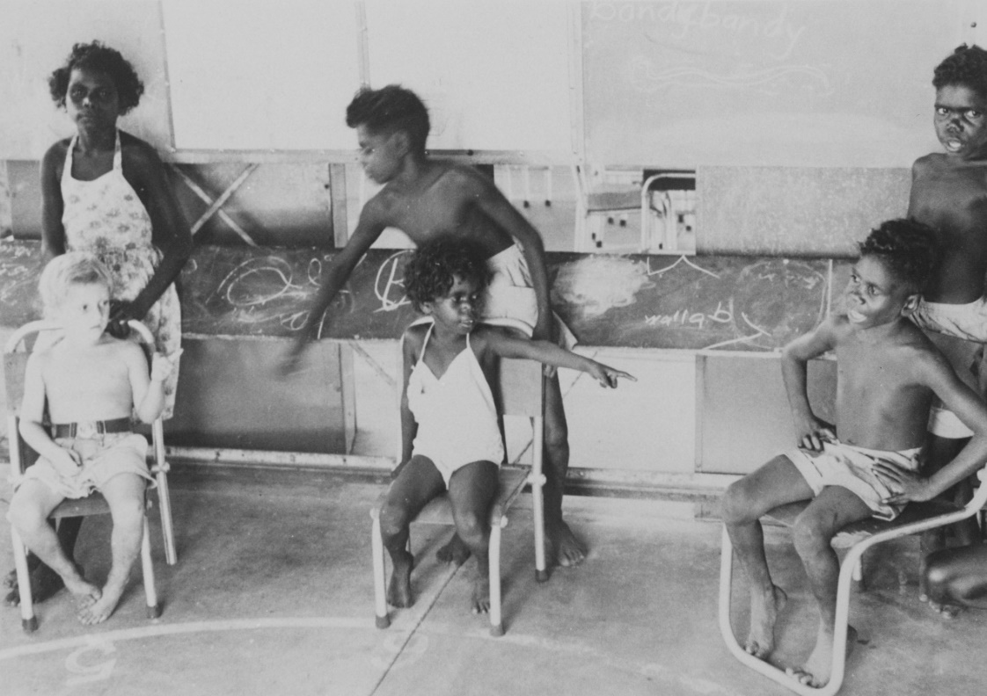
He saw education as key to the work
He was to develop programs under federal government policies to meet objectives in welfare, education, training and employment.
His saw education as integral to the total welfare program.
His responsibilities included oversight of all Preschools in the Northern Territory.
Milikapiti nd: Giese Collection, Northern Territory Library PH0351-0051

Slide 8
His influence was far-reaching
He arrived in Darwin in October 1954 and almost immediately had discussions with the Senior Education Officer about programmes in special schools. In November 1954 as a member of the Northern Territory Legislative Council he foreshadowed in the Council the transfer of education to the new Welfare Branch. Although the Welfare Branch did not specifically give the Director the responsibility of controlling Aboriginal education it did give him the power to ‘arrange’ education for Aboriginal children.
Flynn, K. in Harry Christian Giese Collection 15-036-018/4 page 105: Arafura Archives, CDU

Slide 9
He saw education as key to social change
Education is obviously the major tool in the whole process of social change but the education program should not simply be looked at in terms of formal education restricted to a primary programme but should involve the full range of education services from Preschool through to post-primary, secondary, post-secondary and tertiary and including education in parenthood and child care training and adult education involving literacy and studies of Australian society.
Giese, H. ‘Education, A Key Factor in Aboriginal Advancement’ in Special Schools Bulletin V6 no 3 June 1969 p1

Slide 10
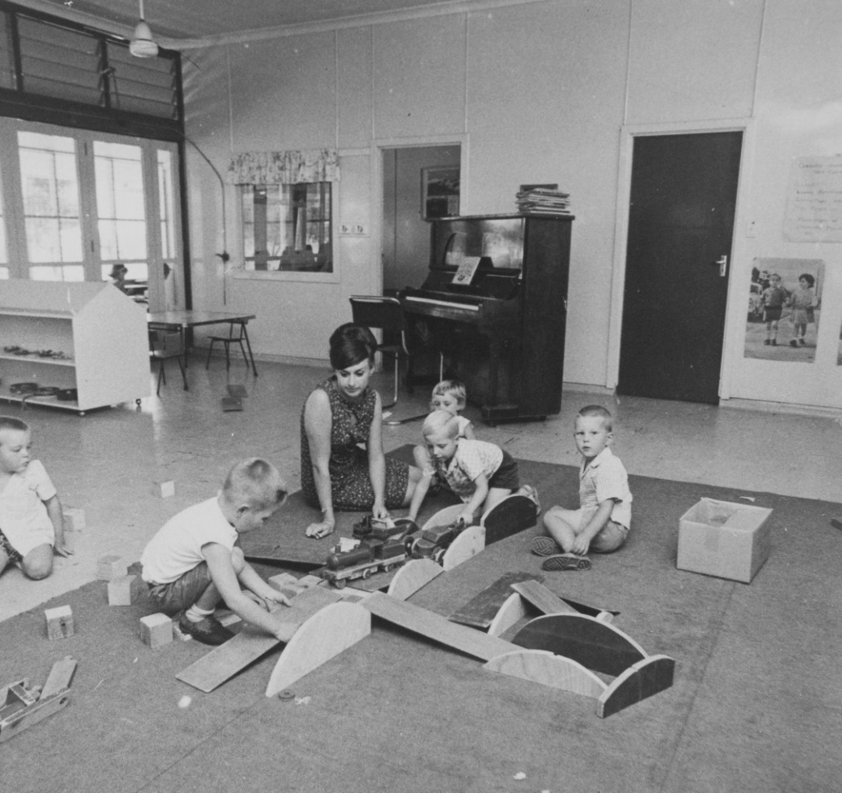
Preschools came under the Welfare Branch
In August 1955, the administration of Preschools, originally under the direction of the Commonwealth Department of Education, was transferred to the Welfare Branch of the Northern Territory Administration.
Harry Giese oversaw all Preschool teachers.
Ida Stanley, nd. Giese Collection, Northern Territory Library PH0351-0072

Slide 11
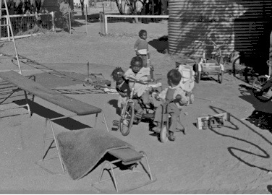
Availability of schooling expanded
Harry accelerated the development of education, opening schools on pastoral stations and new settlements.
Tschirner Collection, Northern Territory Library PH703-0000

Slide 12
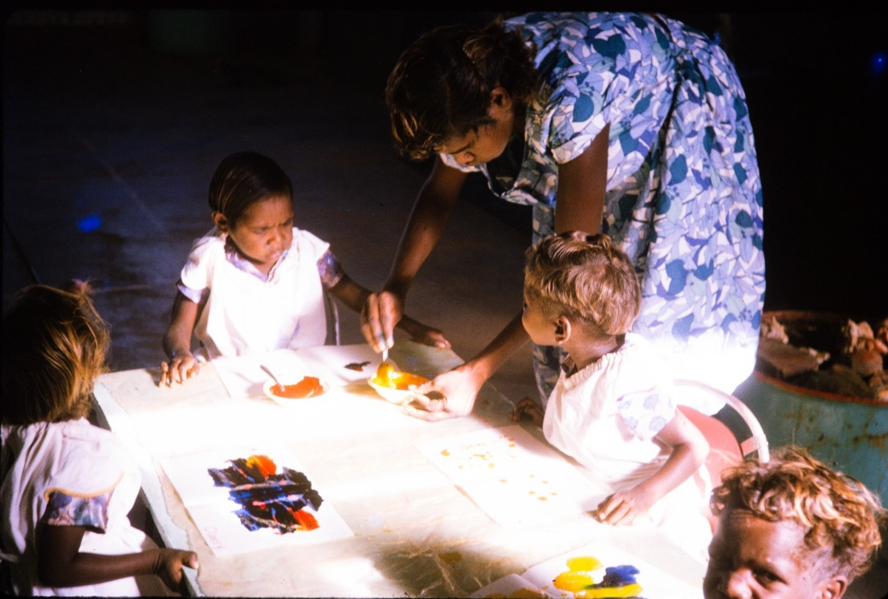
The Branch’s role in Preschools was explicit
The Welfare Branch was responsible for the planning, provision and administration of Preschool education involving:
direction, supervision and implementation of all Preschool staff
organising of training courses for Preschool assistants
liaison between Welfare Branch, parent committees, and other groups interested in Preschool education; and planning of Preschool centres, selection of sites and general layout of equipment
Alekareng 1965, Joyce Gilbert Collection PH0048/0418,
Northern Territory Library

Slide 13
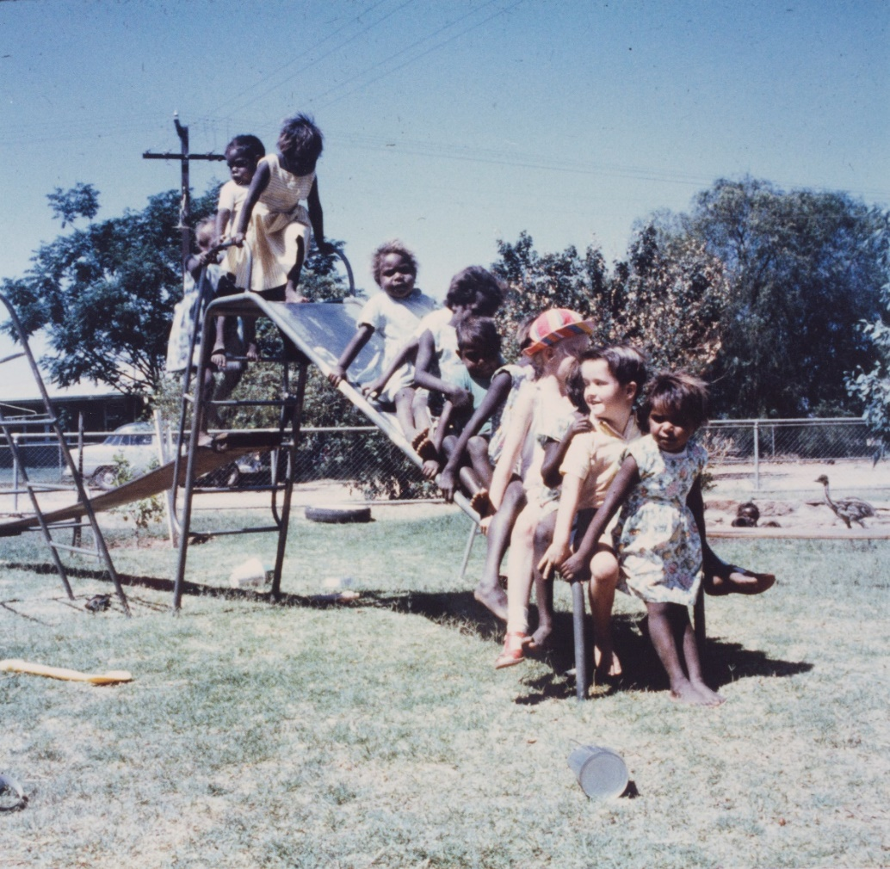
Harry took an active role
By virtue of his position as Director of Welfare, Harry was Chair of the Preschool Association.
Amoonguna 1960: Giese Collection,
Northern Territory Library PH0351-0097

Slide 14
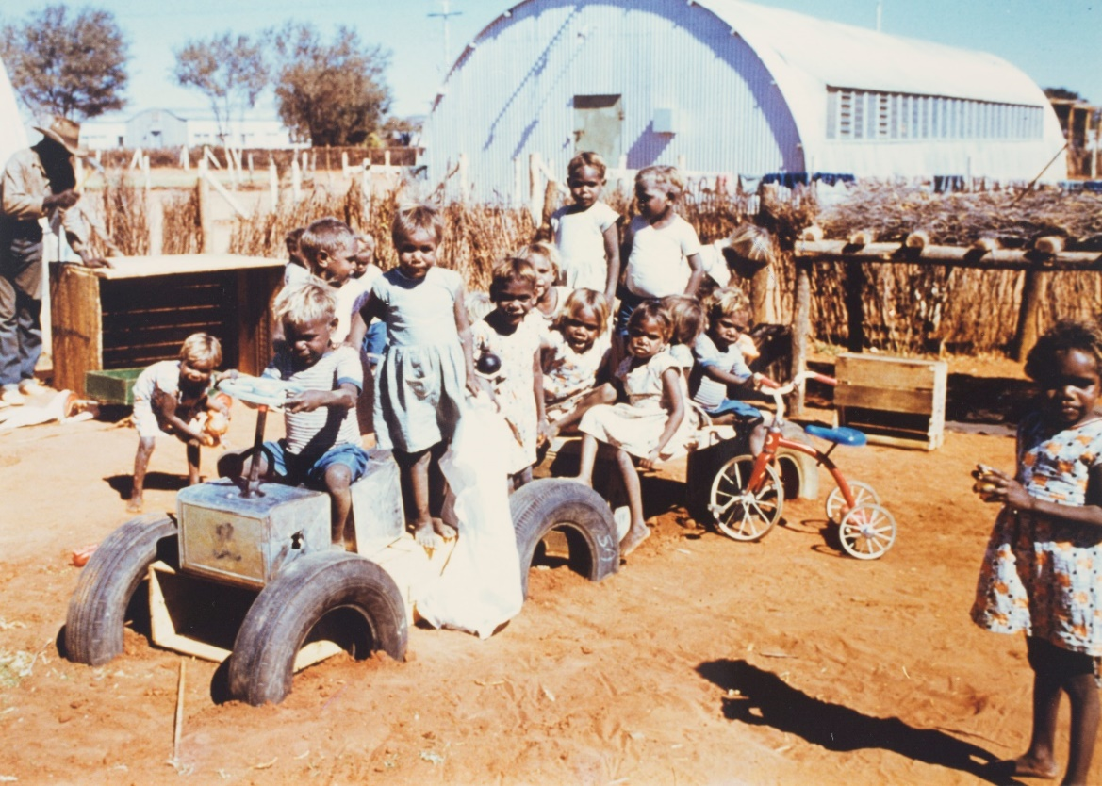
Amalgamation
In 1973, the NT Community School system and the Special Schools for Aboriginals (Welfare Schools) were amalgamated into a single education system for the NT.
The governance arrangements changed and Harry Giese turned his energy and experience to other community work.
Preschool teachers came under the management of the school Principal.
Papunya 1961: Giese Collection, Northern Territory Library PH0351-0130

